Slide 1




First steps in coding
Lets write our first simple program in C#
First steps into
coding
SoftUni Team
Technical Trainers
Software University
http://softuni.bg

Slide 2

Content
What does programming mean?
First program with C# and Visual Studio
Creating C# console application
Executing the program
Testing in the judge system

Slide 3



What does programming mean?

Slide 4
What does programming mean?
To give commands to the computer – to "communicate"
Commands are written one after another as text (source code)
In a sequence they form a "program"
Programs are written in a programming language
For example: C#, Java, JavaScript, Python, PHP, C, C++, …
You use integrated development environment (IntelliJ IDEA)
The source code is compiled to executable file (.exe)
For example Program.cs is compiled to Program.exe
Or it is executed directly
For example the JavaScript source code is interpreted by the web browser

Slide 5
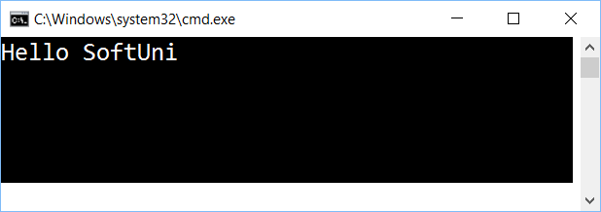
Lets write our first program

Slide 6
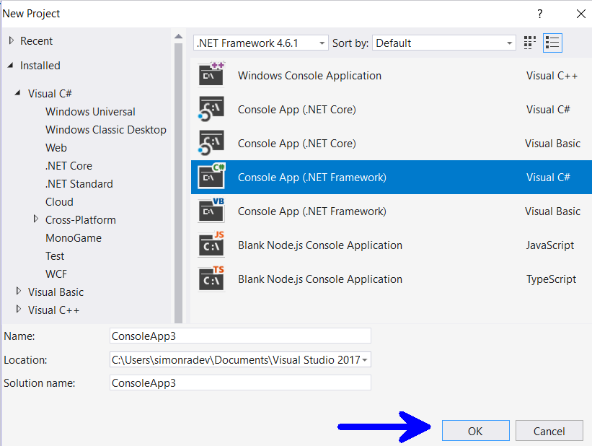
Creating a console application
Start Visual Studio
New console project – [File]→ [New] → [Project] → [Visual C#] → [Console Application]

Slide 7
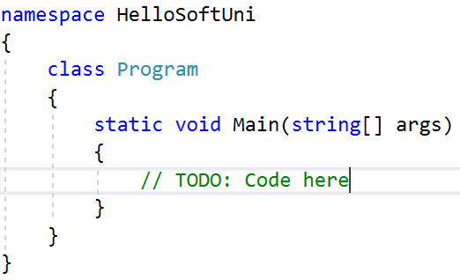
Writing code
Source code is written in the Main(string[] args) method
Between the curly brackets { }
Press [Enter] after the opening bracket {
The code you write is indented

Slide 8
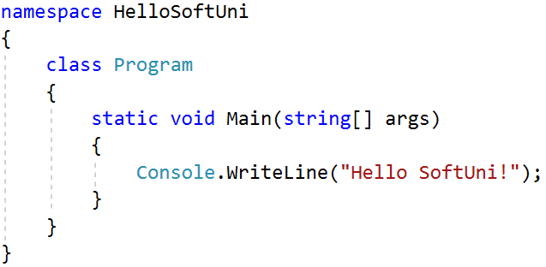
Writing code (2)
Write the following code:
Console.WriteLine("Hello SoftUni");

Slide 9
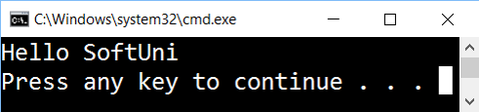
Executing the program
To execute the program press [Ctrl + F5]
If you did not make any mistakes the program will start
The result is going to appear in the console (the black window):

Slide 10
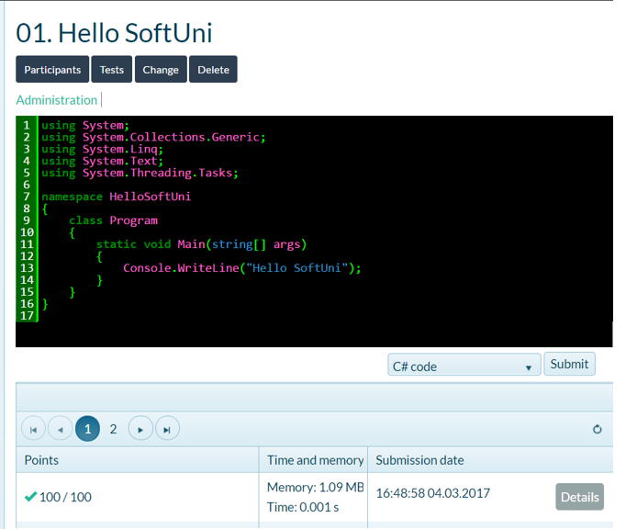
Testing in Judge system
Test your code in the online judge system:
https://judge.softuni.bg/Contests/852/Variables-Data-Types-Expressions

Slide 11






Common mistakes in C# programs
Writing code out of the Main() method body:
Mistaking the letter casing:
Omitting ; in the end of the line:
Omitting " or a bracket ( or ):

Slide 12

Summary
Programming means to give commands to our computer.
The computer program is a sequence of commands
You use programming language (for example C#) + IDE (for example Visual Studio)
The entry point of our program is Main(…)
static void Main(string[] args)
{
Console.WriteLine("Hello");
}

Slide 13







First steps in coding
https://softuni.bg/trainings/1764/fundamentals-of-programming-with-csharp

Slide 14
License
This course (slides, examples, demos, videos, homework, etc.) is licensed under the "Creative Commons Attribution-NonCommercial-ShareAlike 4.0 International" license

Slide 15





Trainings @ Software University (SoftUni)
Software University – High-Quality Education, Profession and Job for Software Developers
softuni.bg
Software University Foundation
http://softuni.foundation/
Software University @ Facebook
facebook.com/SoftwareUniversity
Software University Forums
forum.softuni.bg

